Slide 1



Choosing a college
How to find the right
one for you
2019-20 Academic Year
Notes:
Welcome to Choosing a College: How to Find the Right One for You.
Choosing a college is a pretty big decision, but it’s also an exciting time. Is everyone excited? That’s great.
Deciding on which college you want to attend can be a lot of work, but it can also be a lot of fun.
Today I’m going to give you tips, tools and guidance to make the process of finding the right college less intimidating.
When you leave here you’ll know which questions you need to ask to find and compare colleges so you and your parents can make a more informed decision about which college is right for you.

Slide 2



WHEN YOU FIND THE RIGHT COLLEGE FIT
ACADEMICALLY
SOCIALLY
FINANCIALLY
You’re more likely to:
GRADUATE
Notes:
Now let’s get into why you are all here today—to find the right college fit for each of you.
I’m going to share how you can find a college that meets most of your needs academically, socially and financially.
And the reason this is so important is because when you do, it’s the #1 predictor for college success! And [CLICK] that means you’re more likely to graduate.
[source: University of Connecticut DigitalCommons@UConn, Measuring College Student Satisfaction: A Multi- Year Study of the Factors Leading to Persistence, http://digitalcommons.uconn.edu/cgi/viewcontent.cgi?article=1001&context=nera_2008]

Slide 3



START BY ASKING
YOURSELF SOME QUESTIONS
What do you want to study?
How long do you want to go to college?
What features are important to you?
Do you meet the admission requirements?
What will it cost to attend?
Knowing who you are and what you want from college will help you find the right one for you.
Notes:
To find the right fit, start by asking yourself some questions.
What do you want to study? Do you know? It’s okay if you’re unsure.
How long do you want to go to college? 4 years? Less than a year?
What features do you want the college to have? Big campus? Small campus?
Do you meet the college’s admission requirements? Are your grades good enough to get in?
What does it cost to attend and how much can you afford?
Let’s go through each of these in more detail.

Slide 4


What DO you WANT TO STUDY?
Notes:
So what do you want to study?
As I mentioned before, you’re more likely to become a college graduate if you find the right college fit. You’re also more likely to be successful in the classes where you enjoy studying the subject matter.
So before you choose a college, make sure it offers the subject you are interested in studying.

Slide 5



YOUR INTERESTS
CAN BECOME THE MAJOR
OR PROGRAM YOU STUDY
Think about:
What your favorite
classes are
What your hobbies are
What you love to do
What you can see yourself doing after high school
Notes:
So how do you decide what you want to study?
Think about:
What your favorite classes are
What your hobbies are
What you love to do
What you can see yourself doing after high school
These interests can become the major or program you study.
Majors and programs are a college’s way of placing you on a certain track of classes leading to graduation. Generally, you declare a major your freshman year, or in the case of technical colleges, you select your program for the appropriate hands-on training.
If you don’t know what you want to study that’s ok too. Part of college is discovering what you like and are interested in.

Slide 6










Careers associated with business
Global & International Business
Economics
E-commerce
YOU
ENJOY BUSINESS CLASSES
Agricultural Business
Information Security Analyst
Finance
Public Relations
Marketing
Notes:
[student interaction]
So let’s talk about some specific majors. Maybe you enjoy business classes. Business is one of the most popular areas of study. There are hundreds of business-related classes to choose from, and they vary from college to college.
If you are interested in working in business, what are some majors that you can consider?
(Students talk. Confirm if answers are business majors or not.)
[CLICK]
You get the idea.

Slide 7






Careers associated with arts
3D Animation
Music
Video
Game
Design
Cinematography
YOU SEE YOURSELF AS AN ARTIST
Theater
Dance
Virtual Environments and Simulation
Notes:
[student interaction]
What about art? Maybe you see yourself as an artist. What are some majors that you can think about in the area of fine arts?
[CLICK]

Slide 8


Careers where you work with your hands
Fishing & Wildlife
Certified Nursing Assistant
Farming & Agriculture
YOU LIKE WORKING WITH YOUR HANDS
Welding
Machine
Tool Operations
Culinary
Arts
Construction and Remodeling
Notes:
[student interaction]
What if you like working with your hands?
What are some things you might do if you want to work with your hands?
[CLICK]
For some of these, you might be in school for only a year or two. How nice would it be to be done with college and doing something you like in two years or less?

Slide 9

How long do you want to go to college?
Notes:
The next question you want to ask yourself is how long do you want to go to college?
Some of you may want to stay in college for 4 years or more. Some of you may want to get out of college and get a job as soon as possible—that’s an option too.

Slide 10






Different degrees
Certificate
Master’s
Associate
Bachelor’s
Doctorate (Ph.D.)
Technical Diploma
AND THE TIME IT TAKES
TO EARN THEM
Notes:
The length of time you spend in college will determine the type of degree you earn.
Let’s look at the various degrees and the time it takes to earn them.
[Complete this activity one degree at a time with the students. Once the technical diploma answer is given, move to the next slide so the students can see the degrees in order of the time it typically takes to complete them]

Slide 11
Different degrees continued
Certificate
Technical Diploma
Associate
Bachelor’s
Master’s
Doctorate (Ph.D.)
AND THE TIME IT TAKES
TO EARN THEM
Notes:
As you can see, you can go to college and get some type of degree in as short as six months, or you can go for more than 7 years. You have a number of choices, and the time it takes to complete your degree varies.
Choosing a college is closely related to the type of degree you want to pursue, and the type of degree you want to pursue is closely related to a career choice. Again, you don’t have to have all the answers now, but there are many options to think about.
[Tell your personal story or a personal story of someone who went 1-2 years and is happy doing “X career” and another story of someone who went to college 4 years and is happy doing “X career” and maybe another example of someone who went back to college after several years to finish a master’s, etc.]

Slide 12

DIFFERENT COLLEGES OFFER
DIFFERENT MAJORS, PROGRAMS, AND DEGREES
TECHNICAL COLLEGE—Certificate, Technical Diploma and Associate Degree
2-YEAR COLLEGES—
Associate Degree
4-YEAR COLLEGES—
Bachelor’s Degree
Notes:
It’s important to note that there are different types of colleges and they all offer different majors, programs and degrees.
You can earn a certificate, technical diploma or even an associate degree from a technical college, or earn your associate degree from a 2-year college.
Or maybe you’ll need a bachelor’s degree from a 4-year college. You can also earn graduate degrees at 4-year colleges.

Slide 13



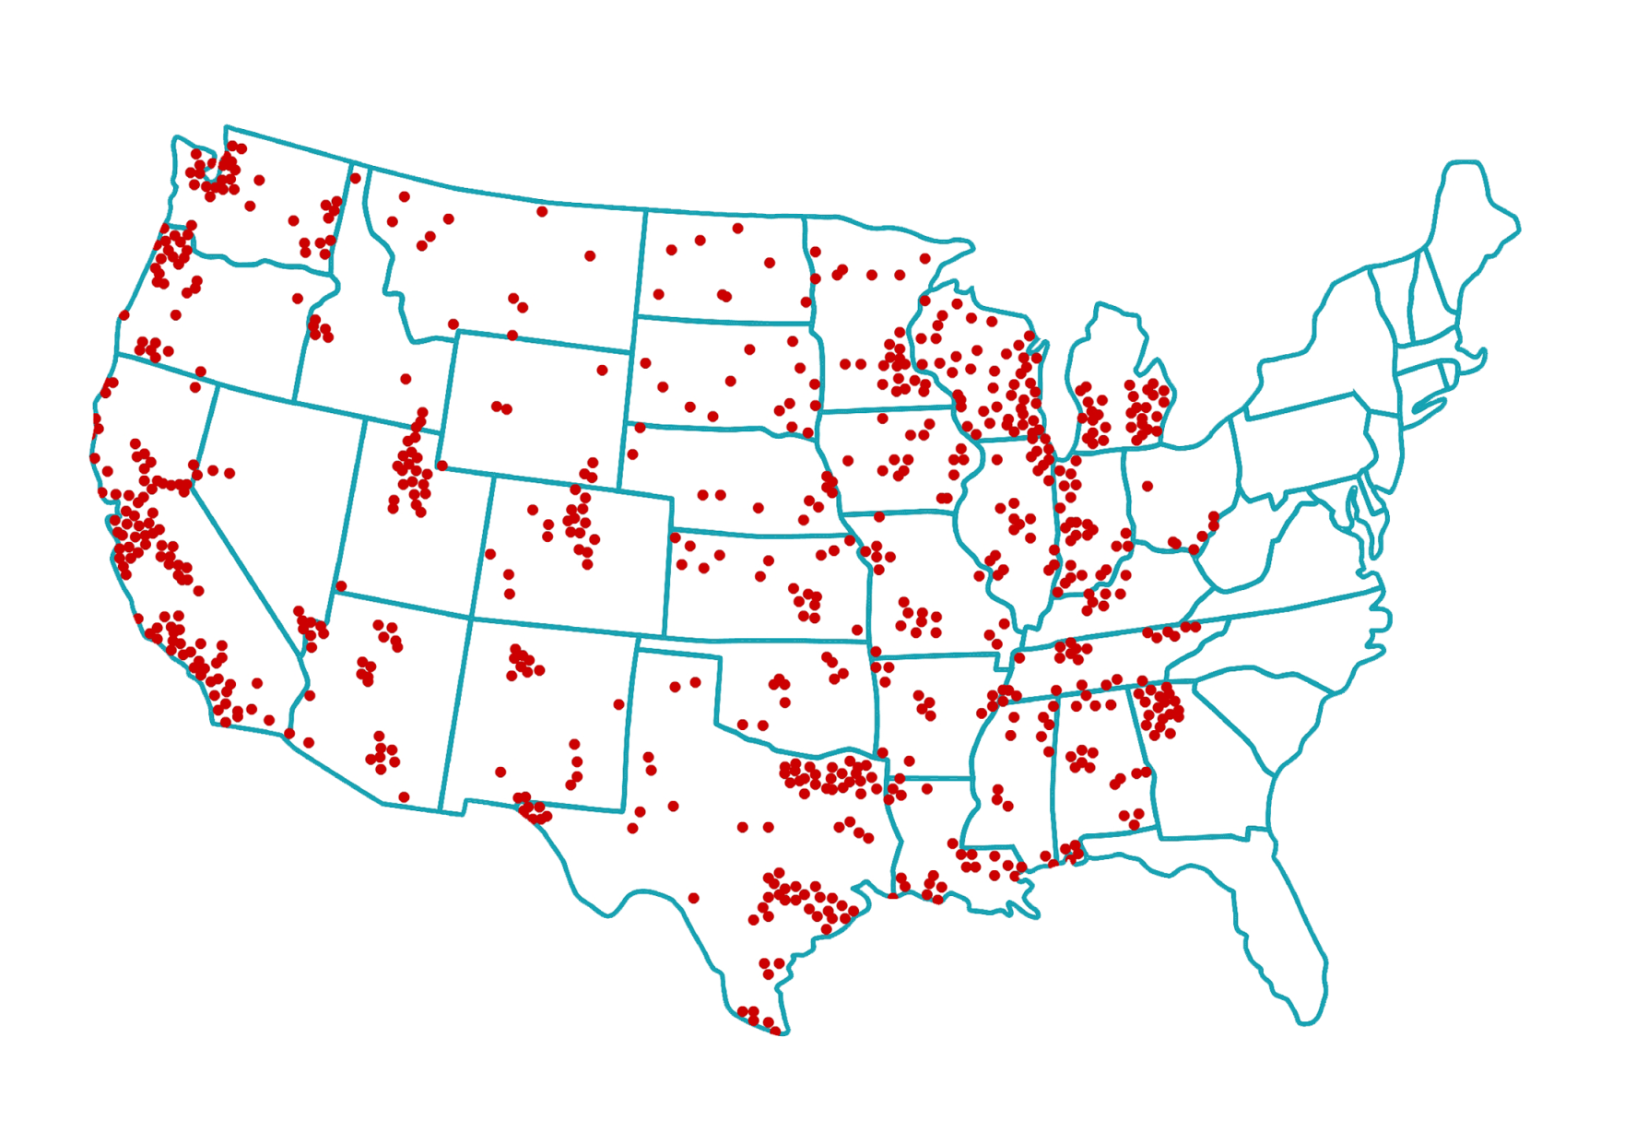
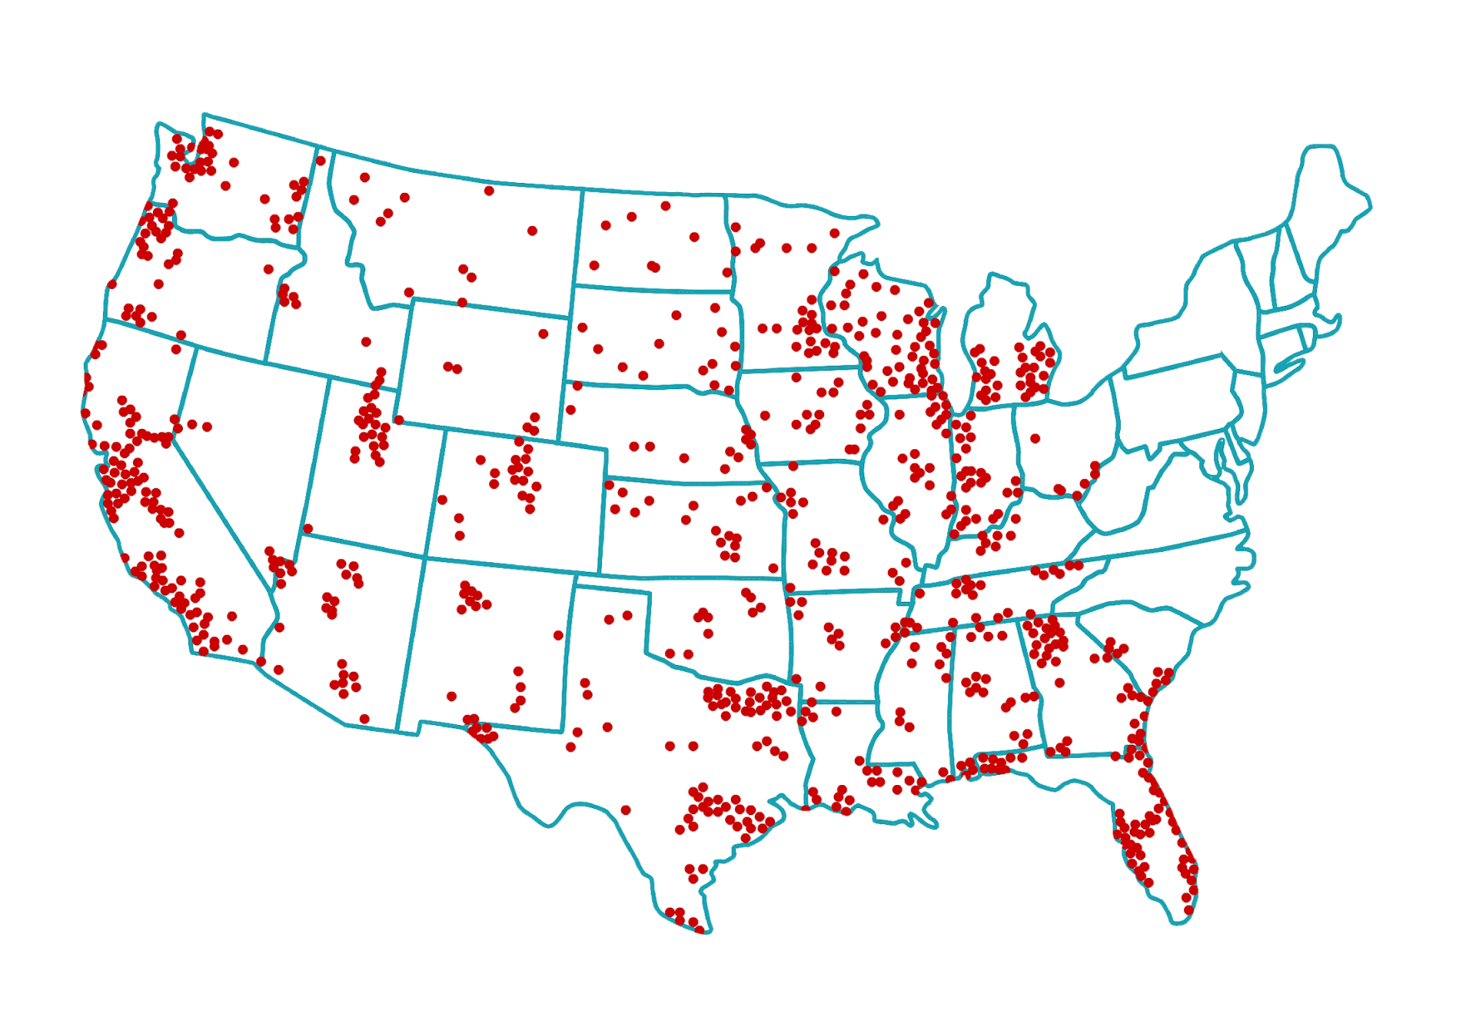
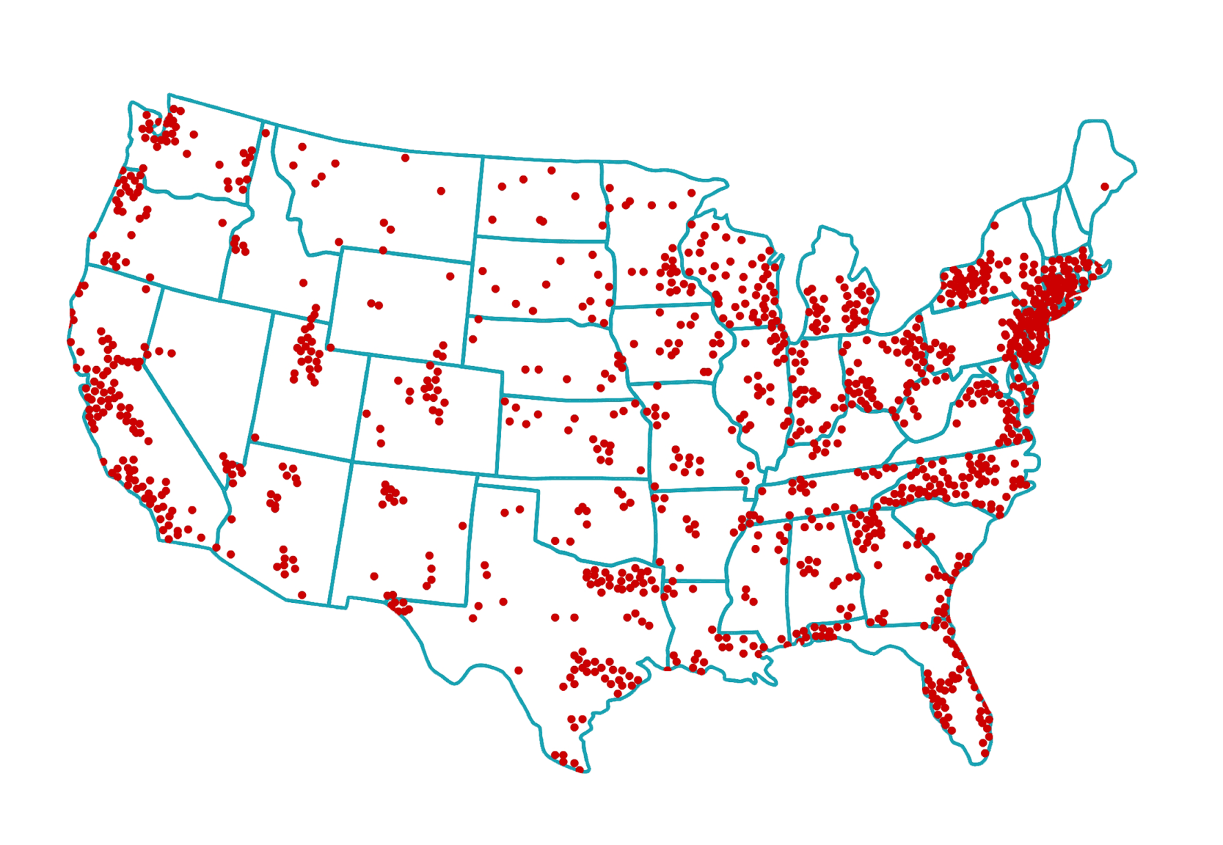
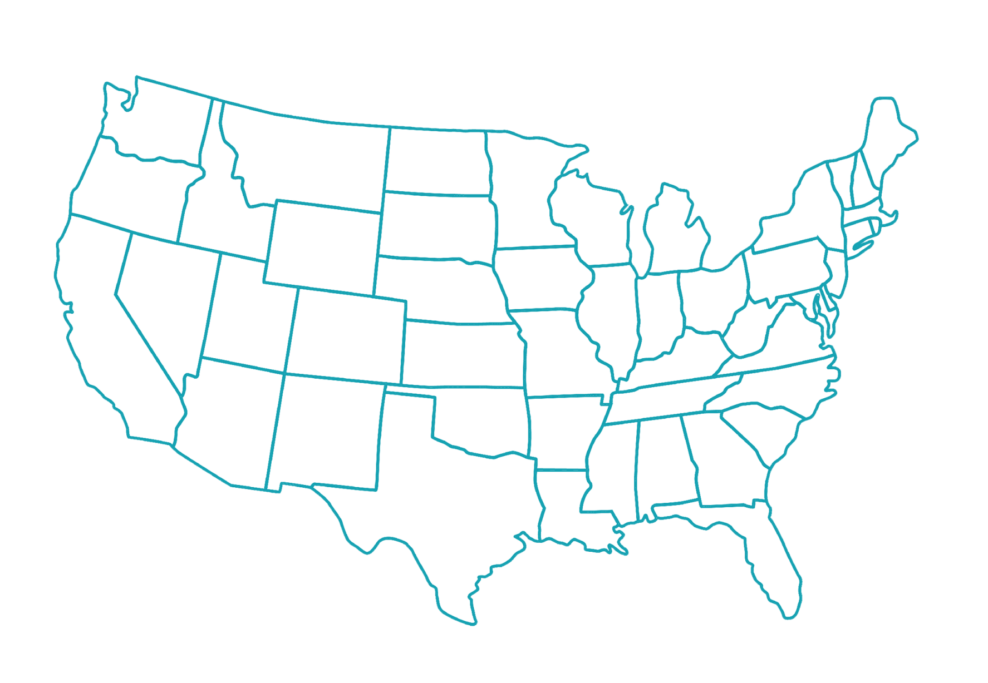
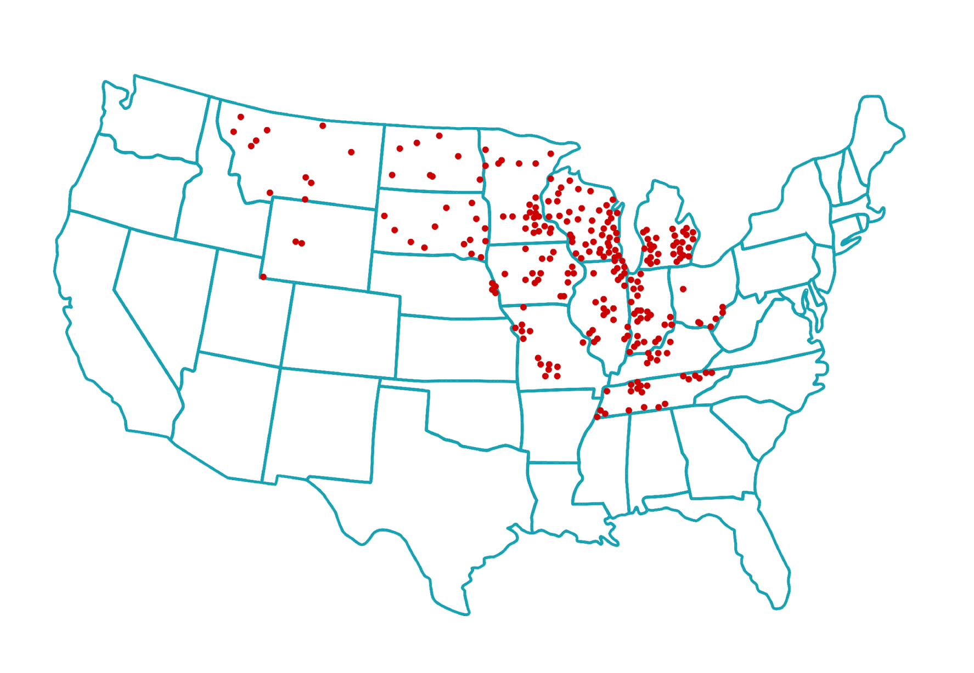
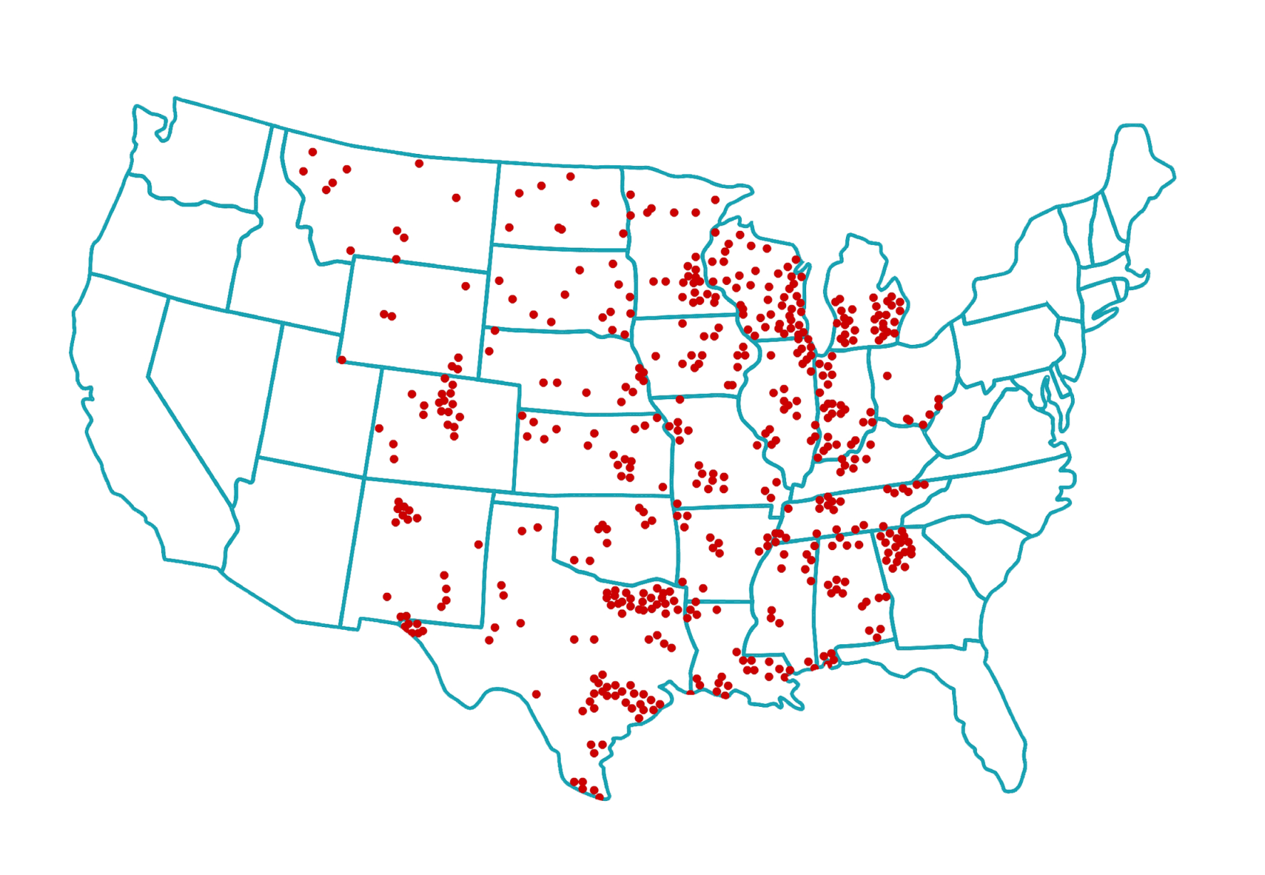
GOOD NEWS—YOU HAVE LOTS
OF COLLEGES TO CHOOSE FROM
  Over
  7,000
  in the U.S.
Notes:
You have lots of colleges to choose from to find a program that is right for you.
[student interaction]
Shout it out—how many colleges are in the U.S.--1,000? 10,000?
[Click]
There are over 7,000 colleges and universities across the US.
You have lots of college options to choose from.
[note: 7,000 is based on the number of postsecondary title 4 institutions found in a NCES report, includes non-profit and for-profit colleges (National Center for Education Statistics) https://nces.ed.gov/fastfacts/display.asp?id=84]

Slide 14
Differences between public and private
Public Nonprofit
Eligible for State Aid
Credits may transfer
Eligible for State Aid
Credits may transfer
Private Nonprofit
Private For-profit
What are the differences?
NOT Eligible for most State Aid
Credits likely will NOT transfer
Tuition costs could be up to
4.5 TIMES HIGHER
Notes:
These 7,000 colleges are made up of different types of colleges. Let’s talk about the distinctions.
In addition to a college being a technical, a two-year, or four-year college, it could also be public or private and nonprofit or for-profit.
Essentially, nonprofit colleges are the same no matter if they are public or private—they are both eligible for state aid and most of their credits will transfer to other colleges.
The big difference is with for-profit colleges, which are not eligible for most state aid, their credits don’t transfer and their tuition can be up to 4.5 times higher than nonprofit colleges.
There are other differences than what I’ve listed here, but the main point to remember: If the college you are looking at is listed as a “FOR-profit,” be sure to compare it to some nonprofit colleges to ensure you don’t pay more for a degree than you need to.

Slide 15

DIFFERENT COLLEGES OFFER
DIFFERENT MAJORS, PROGRAMS AND DEGREES (1 of 5)
Madison Area Technical College
  Technical Diploma in Nursing (1 year)
  Associate Degree in Nursing (2 years)
UW-Madison
  Bachelor of Science Degree in Nursing (4 years)
Edgewood College
  Bachelor of Science Degree in Nursing (4 years)
Notes:
Now let’s look at some examples of how different colleges offer different majors, programs and degrees.
Say you want to study nursing and live in Madison, Wisconsin. You have choices.
[take students through the nursing options available at colleges in Madison]
Madison Area Technical College
Technical Diploma in Nursing (less than 1 year)
Associate Degree in Nursing (2 years)
UW-Madison
Bachelor of Science Degree in Nursing (4 years)
Edgewood College
Bachelor of Science Degree in Nursing (4 years)
Knowing what you want to study and the type of degree it will take is a good place to start when you look at choosing a college.

Slide 16


DIFFERENT COLLEGES OFFER
DIFFERENT MAJORS, PROGRAMS AND DEGREES (2 of 5)
Northcentral Technical College
Welding Robotic Operation Technical Diploma (1 year)
Welding Technical Diploma (1 year)
Welding Fabrication & Robotics Associate Degree
(2 years)
Mid-State Technical College
Welding Technical Diploma (1 year)
Notes:
Here’s another example showing Northcentral and Mid-State Technical Colleges in Wisconsin. Both offer the same one year diploma and Northcentral offers two additional programs that Mid-State doesn’t.
[take students through the welding options available at colleges in Wausau and Wisconsin Rapids]
Northcentral Technical College
Welding Robotic Operation Technical Diploma (1 year)
Welding Technical Diploma (1 year)
Welding Fabrication & Robotics Associate Degree (2 years)
Mid-State Technical College
Welding Technical Diploma (1 year)

Slide 17


DIFFERENT COLLEGES OFFER
DIFFERENT MAJORS, PROGRAMS AND DEGREES (3 of 5)
BACHELOR’S DEGREE
IN ENGLISH
vs.
UW-Milwaukee
UW-Stout
Notes:
Just pay attention to what each college offers.
For example, University of Wisconsin-Milwaukee and University of Wisconsin-Stout are both four-year colleges, but they don’t offer the same degrees.
[CLICK]
UW-Milwaukee offers a Bachelor’s degree in English and UW-Stout doesn’t.

Slide 18
DIFFERENT COLLEGES OFFER
DIFFERENT MAJORS, PROGRAMS AND DEGREES (4 of 5)
APPLIANCE
TECHNICIAN DIPLOMA
vs.
Milwaukee Area Technical College
Madison
Area Technical College
Notes:
Here’s another example.
Milwaukee Area Technical College offers an Appliance Technician diploma [CLICK], but Madison Area Technical College doesn’t.

Slide 19
DIFFERENT COLLEGES OFFER
DIFFERENT MAJORS, PROGRAMS AND DEGREES (5 of 5)
Do some research:
Visit college websites to see what programs or majors they offer
Ask your counselors
and teachers for help
Use websites to find
and compare colleges
bigfuture.org
College Navigator
(nces.ed.gov/collegenavigator)
Notes:
To find out if a college offers the program or major you want to study and the degree you want, you need to do some research.
An easy way to do this is:
Visit college websites to see what they offer
Ask your counselor and teachers for help
Use websites like bigfuture.org and College Navigator (nces.ed.gov/collegenavigator) to find colleges and compare them

Slide 20


What FEATURES ARE IMPORTANT TO YOU?
Notes:
Another question to ask yourself is what features are important to you.
[student interaction]
What do I mean when I say features?
Can anyone give me an example of features you may look for in a college?
Great, let’s explore some features in more detail so you can get to know what is important to you in a college.

Slide 21




THINK ABOUT
  Location/setting
  Size
  Retention & graduation rates
  Housing options
  Student population
Notes:
Location/setting
Do you want to be close to home or farther away from home?
What setting do you prefer, rural, suburban or urban?
Size
Do you prefer a big campus or smaller campus?
What size class do you learn best in?
Housing options
Where do you want to live? In a dorm? In an apartment?
Do you want to live at home with your parents?
You might also want to compare retention and graduation rates at colleges. The retention rate is the percentage of a school's first-time, first-year undergraduate students who continue at that school the next year. The graduation rate is the percentage of students who complete college. These are good indicators of student success at a college.

Slide 22

Are there things to do that interest you when you are not in class?
Sporting events
Music
Theatre
Cultural activities
Religious activities
Campus groups
Notes:
Ask yourself what you like to do. What are the things that interest you when you are not in class? How important are they when choosing your college fit?
Sporting events
Music
Theatre
Cultural activities
Religious activities
Campus groups
[Student interaction]
Anything else?
An easy way to find out about intramural sports, clubs and other things that might interest you, is by searching for Student Life on college websites.

Slide 23

DO YOU MEET THE ADMISSION REQUIREMENTS?
Notes:
Another question you need to ask is if you meet the admission requirements, like GPA and ACT/SAT scores.

Slide 24


Know what it takes to get into the colleges you are interested in
Technical colleges
Open enrollment
Requires a high school diploma
Typically no GPA requirement
2-year and 4-year colleges
Search college websites
Admission requirements
  Required high school classes
  Grade point average
  Standardized test scores
    ACT or SAT taken your junior or senior year
Notes:
It’s important for you to know what it takes to get into the colleges you are interested in.
If you plan on going to a technical college there is typically no GPA requirement. Most programs have guaranteed acceptance, meaning they can’t turn you down. So a tech school is an option everyone can consider, no matter what kind of grades you have.
Check college websites for specific program information or ask the college admission counselor.
[CLICK]
2-year and 4-year colleges have different requirements—check college websites to see what classes you need to take in high school, if there is a minimum GPA and if taking the ACT or SAT is necessary.
Find this information by going to each college’s website and typing something like “required GPA” “admissions requirements” or “ACT” and “SAT” in the search bar.
It is important to know all of the requirements of all the colleges you are thinking about attending. Having all of this information will help you choose the college that will be the best fit for you!

Slide 25


WHAT WILL
IT COST
TO ATTEND?
Notes:
And finally, consider the cost of college.

Slide 26

The cost of college includes
Tuition and fees
Room and board
(where you live
and what you eat)
Books and supplies
Travel and personal
expenses
Notes:
When you look at the cost of college, it includes many things and each can vary by college.
Tuition and fees
Tuition is the cost of taking classes—some classes and programs cost more than others.
Fees are charged for a variety of things and can include office administration fees, application fees, activity fees and enrollment fees.
Room and board
This is where you live and what you eat. You may live in a dorm and have a campus meal plan; or you may have an apartment and buy your own food; or you may continue to live at home.
Books and supplies
You’ll need books for classes. You’ll also need supplies which can include everything from notebooks and pens to a laptop, lab equipment or art supplies.
Travel and personal expenses
This will depend on where you live, you may have to commute to school every day. You may also want to include clothing and mobile phone costs.
All these costs will be unique to you, and their sum will be your cost of attendance.

Slide 27
APPLY FOR FINANCIAL AID
Complete the FAFSA®
(Free Application for Federal Student Aid)
Financial aid can lower the cost of college
Grants
Work-study
Scholarships
Student loans
Notes:
Financial aid can help you pay for college.
In order to receive financial aid, you have to complete the Free Application for Federal Student Aid or FAFSA – you do this during your senior year in high school. By completing the FAFSA, you become eligible for federal grants, work-study, student loans, grants and scholarships from colleges.
Grants and scholarships are money that does not have to be repaid!
Work-study is money you earn from working a job on campus.
Loans are money that you borrow and have to repay.
Even if you don’t think you are going to college—complete the FAFSA—you might be surprised by how much money you are eligible for and it might change your mind.
Most students pay less than the price listed on a college’s website thanks to financial aid.

Slide 28
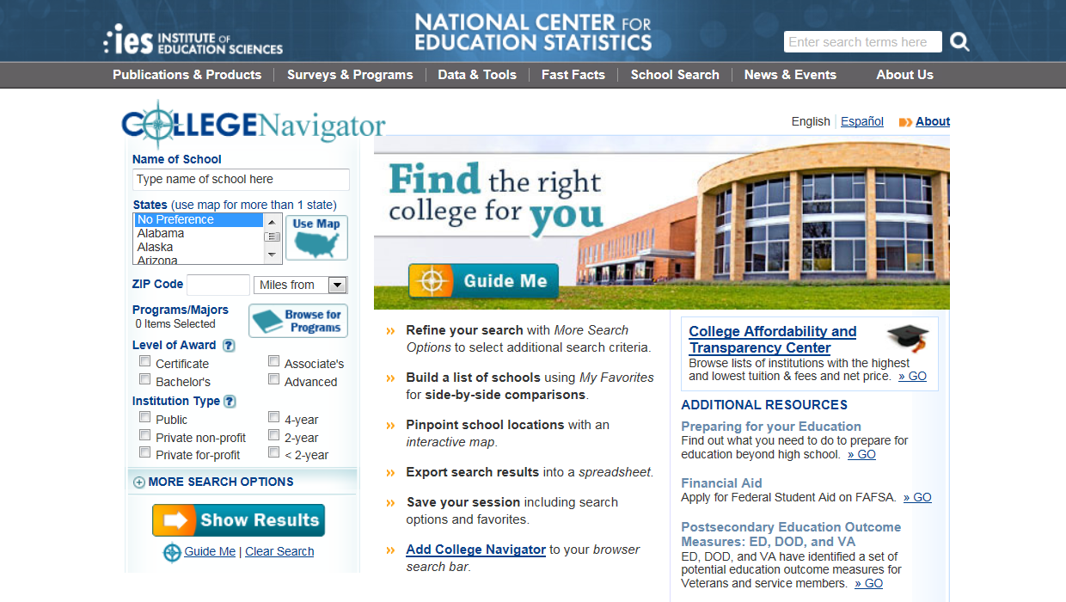
USE COLLEGE NAVIGATOR
TO COMPARE COLLEGES
nces.ed.gov/collegenavigator
Notes:
Now let’s use the College Navigator to find colleges by the programs and majors they offer and compare them based on what we’ve been talking about today—features, admission requirements, and cost.
Since the URL is not easy to remember, the best way to find the site is to Google “College Navigator”—you know you’ve found it when you see National Center for Education Statistics.

Slide 29




WHAT IF YOU WANT TO STUDY COMPUTER ENGINEERING?
Let’s compare
4 COLLEGES
that offer that major
Notes:
What if you want to study computer engineering in Wisconsin?
Let’s compare 4 of the colleges I found in WI that offer that major.

Slide 30
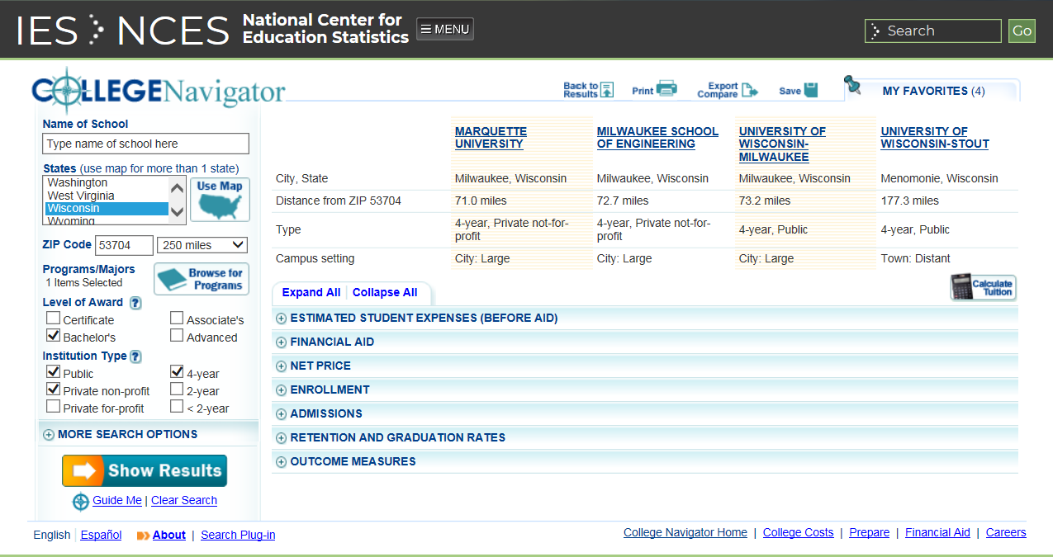
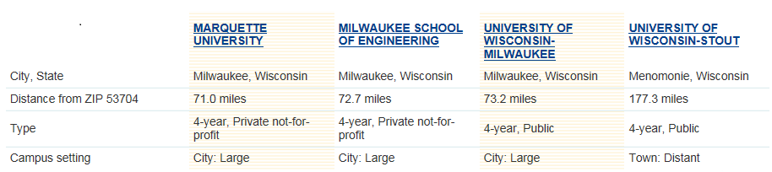
College Navigator (1 of 2)
nces.ed.gov/collegenavigator
Notes:
Marquette, Milwaukee School of Engineering, UW Milwaukee and UW Stout all offer the major.
[Click]
College Navigator can show you how far each is from the zip code you enter (in this case how far they are from Madison) and tells you what type of college each is and about the campus setting.
So not only is it telling us that each college is a four-year college, but it also tells us if it is public (which is nonprofit), private nonprofit or private for-profit.
We can see that:
Marquette is a private nonprofit in the city.
Milwaukee School of Engineering is a private nonprofit in the city.
UW Milwaukee is a public nonprofit in the city.
UW Stout is a public nonprofit in a town.

Slide 31
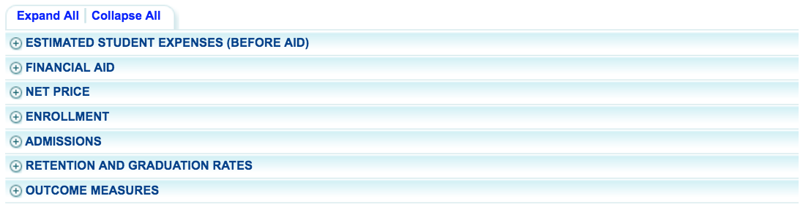



College Navigator (2 of 2)
nces.ed.gov/collegenavigator
The cost to
attend the college
The type of aid students receive and the average amount received
The average prices students pay to attend by income
The genders, races/ethnicities, and ages of students attending
The percentage of students admitted and SAT/ACT test scores
Percentage of students
who stay in college and the percentage of those graduating
The number of students
who earn a degree/certificate within 6 or 8 years
Notes:
The College Navigator can tell you a lot about a college.
[NOTE: CLICK required for each callout]
You can see the estimated cost to attend each college.
You can look at how much financial aid students receive.
You can look at the real price students paid to attend college after financial aid is applied.
You can look at the breakdown of the student enrollment (including by gender, race, and ethnicity).
You can look at admissions which includes standardized test scores of the student population.
You can also look at retention rate (that’s the number of first-time students who return to college) and graduation rates, as well as how many students earn a degree or certificate within 6 or 8 years of when they started.
This is a really good tool to use to research and compare colleges.

Slide 32


PLANNING YOUR college VISIT
Notes:
Once you’ve found the college or colleges that interest you and meet your criteria, the next step is to plan a visit.
[student interaction]
Can anyone tell me why it is important to visit colleges?
Visiting a college can give you a better feel for a college’s campus and the students. While you can find out a lot about a college online, being on campus is very different and allows you to experience what a “day in the life” of one the college’s students is like and what one of your days on that campus might be like. You can see what the dorms or student housing looks like, and you can check out the library and student centers. So if it is possible for you to make the trip, it is worth it!

Slide 33


SEE IT
FOR YOURSELF
Go to the college’s website and search “visit”
or “tour campus”
Find contact information to call and set up your
visit or ask questions
Schedule your visit while college classes are in session
(ideally Monday through Thursday)
Ask if the college sponsors an overnight program
to get an even better feel for the campus
Notes:
To plan your visit:
Go to the college’s website and search “visit” or “tour campus” and find out who you need to contact to schedule a visit.
You’ll want to try to schedule a visit when classes are in session so you can get a good idea of what it is like to be a student on that campus.
Plan ahead of time to make sure that you’ll see some classrooms and student centers and the dorms and cafeteria if you want to live on campus.
Ask if the college sponsors an overnight program to get an even better feel for the campus.
If you can’t visit:
Many colleges offer online virtual tours. It saves time and money, but is not the same as being on campus.
Ask each college if they can put you in touch with current or past students willing to answer your questions.
Follow colleges on social media and read about them online to get a sense of what they are like.
Request more information from the admissions office.

Slide 34


You should also attend college fairs
Lets you talk
to college admissions representatives about:
Available programs, majors, and degrees
Cost
Admission requirements
Other features of the college
Notes:
You can also learn about colleges by attending a college fair. A college fair is a great opportunity to meet with representatives from several colleges at one location. You get the chance to ask questions about each college, including what you could study and what life is like on the campus. If the college is in a city or state that you haven’t been to before, you can ask about that too.
How do you find out about college fairs? Ask your high school counselor; they should be able to tell you if there are any scheduled. You can also Google “college fairs 2019” and a listing of websites will come up that you can look through and find a college fair to attend!
[share any college fairs you know about]

Slide 35

REVIEW
You have lots of options when it comes to college
Over 7,000 colleges and universities in the U.S.
Finding the right college increases your likelihood
of graduating
When choosing a college, consider:
  What you want to study
  How long you want to attend
  Features that are important to you
  Admission requirements
  Cost to attend
Use resources like College Navigator to find
and compare colleges
Notes:
We talked about a lot today, so let’s do a quick review.
You are empowered to choose a college and you have lots of options to choose from –including over 7,000 in the U.S. that are technical colleges, 2-year colleges, and 4-year colleges.
Finding the right college increases your likelihood of graduating.
When looking at colleges you want to consider:
What you want to study
How long you want to attend
Features that are important to you
Admission requirements
Cost to attend
Use the resources available to you like College Navigator to find and compare colleges.

Slide 36



Thank you for attending
© 2019 Ascendium Education Group, Inc. All Rights Reserved.

