Slide 1
Calculating the Price of College
It’s less than you might think
2019-20 Academic Year
Notes:
Welcome to Calculating the price of college: It’s less than you might think
So you’ve probably heard that college is expensive, and it can be.
But we’re going to talk about all the ways you can reduce your cost.
The fact is, there are billions of dollars available to help you pay for college. This includes federal and state grants as well as college scholarships. And this is money you don’t have to pay back. It’s literally free money you can use to pay for college.
Today I’ll show you some online tools you can use to get an idea of how much financial aid you could get and give you an idea of how much each college might cost you based on your family’s situation.
When you leave here today, you’ll be able to evaluate the cost of different colleges and you and your family can make a more informed decision about which college is right for you.

Slide 2
The Two Prices of College: Sticker Price
THE TWO PRICES
OF COLLEGE
STICKER
PRICE
The cost of attendance that colleges list in brochures
and on websites
Notes:
Okay, now we’ll start talking about the price of college.
The first thing to know is college prices are a little like car prices. There’s the sticker price (usually referred to as the cost of attendance) and then there’s the price you actually pay. And just so you know, when you’re buying a car, only chumps pay the sticker price.
Now you’re not going to be negotiating with a salesperson about the college sticker price, but if you tap into the resources available to you, like grants and scholarships, you can lower the price you ultimately pay—sometimes by tens of thousands of dollars.
[Click]

Slide 3
The Two Prices of College: Net Price
THE TWO PRICES
OF COLLEGE
NET
PRICE
STICKER
PRICE
The full cost of attendance that colleges list in brochures
and on websites
The
REAL
amount
you pay
Notes:
That lower number is called the net price. That’s the real amount you will pay—and that’s the price that really matters to you.

Slide 4
Calculating Net Price
CALCULATING NET PRICE
$7,254
−
−
−
$9,916
$17,170
Sticker Price
The college’s published
cost of attendance
Grants & Scholarships
Federal, state or college money
Your Net Price
Does not include federal work-study and student loans or private scholarships
Notes:
Here’s a look at how net price is calculated.
Sticker price (or cost of attendance) MINUS any estimated grants and scholarships you might receive EQUALS your lower net price.
Grants and scholarships are money that you don’t have to pay back.
Now let’s look more closely at each of these parts of the equation.

Slide 5
How Much is the Sticker Price?
HOW MUCH IS THE STICKER PRICE?
It’s different for each college
Cardinal Stritch: $42,654
UW-Green Bay: $19,334
UW-Fond du Lac: $19,079
Southwest Wisconsin Technical College: $17,170
Notes:
Let’s start with sticker price. How much is the sticker price of college? What does a year of college cost?
[student interaction]
Can anyone tell me?
[Click]
The answer is it’s different for each college.
Colleges publish their cost of attendance so you can get an idea of how much you might have to pay.
[Click]
Here are a few examples using colleges in Wisconsin. Cardinal Stritch is a private 4-year college. UW-Green Bay is a public 4-year college. UW-Fond du Lac is a public 2-year college and Southwest Wisconsin Technical College is of course a technical college.
As you can see there is quite a range in their sticker prices.
(Prices according to collegecalc.org)

Slide 6
It includes:
HOW MUCH IS THE STICKER PRICE?
Tuition and fees
Books and supplies
Room and board (where you live and what you eat)
Transportation
Notes:
Sticker price includes:
Tuition and fees
Tuition is the cost of taking classes—some classes and programs cost more than others.
Fees are charged for a variety of things and can include office administration fees, application fees, activity fees and enrollment fees.
Books and supplies
You’ll need books for classes. You’ll also need supplies, which can include everything from notebooks and pens to a laptop, lab equipment or art supplies.
Room and board
This is where you live and what you eat. You may live in a dorm and have a campus meal plan; or you may have an apartment and buy your own food; or you may continue to live at home.
Transportation
This will depend on where you live. You may have to commute to school every day.
All these costs will be unique to you.
Add this all up, and that’s the cost of attendance—the sticker price. Now let’s look at the money available to help you reduce the sticker price and get a college education without paying the full price.

Slide 7
How can YOU REDUCE WHAT YOU PAY?
Complete the Free Application for Federal Student Aid (FAFSA®)
As soon as possible after October 1 of your senior year
The
is the number one source of money to help students pay for college.
federal government
federal government
Notes:
It all starts with the form known as the FAFSA!
Has everyone heard of the FAFSA? Raise your hand if you are familiar with the Free Application for Federal Student Aid.
Did you know that the government is the #1 source of money to help students pay for college?
In order to do this, they need to know who needs money. The FAFSA is how you share the details of your family’s financial situation with the government.
The FAFSA is the key to unlocking the money available through federal and state grants as well as state and college scholarships. Completing the FAFSA is probably the most important step you will take to get to college, and it’s how you reduce the sticker price of any college you want to attend.
You want to complete the FAFSA as soon as possible after October 1st of your senior year in high school.
And you want to complete it regardless of the type of college you are going to--technical, 2-year or 4-year. The earlier you complete it, the better chance you have of getting more financial aid.
Maybe you’ve heard the FAFSA is complicated and hard to complete; but the truth is, it will only take you about an hour to fill it out. And I’m going to show you how the time you spend can get you access to up to $13,000 or more in free money. That’s a pretty good hourly wage. In fact, that’s CEO money!

Slide 8
FAFSA.GOV
FAFSA.GOV
Notes:
This is a screen shot of the official FAFSA.gov website. This is the only FAFSA website you need to know. Avoid all other FAFSA websites—many may try to charge you a fee to complete the FAFSA. So only go to FAFSA.gov and remember it’s always free to complete the FAFSA!

Slide 9
FAFSA.GOV Mobile App
FAFSA.GOV
Notes:
New! You can complete the 2020–21 FAFSA using the myStudentAid app. Download the myStudentAid app in the Apple Store (iOS) or Google Play (Android). Note: If you downloaded the app prior to Oct. 1, 2018 you must download an update to access the 2020–21 FAFSA form.

Slide 10
THESE STUDENTS COMPLETED THE fafsa
85%
of full-time students received aid in 2015-2016
Notes:
So why is it so important to complete the FAFSA? So you can be like the huge majority of full-time students who received financial aid in 2015-16.
At 4-year degree-granting postsecondary institutions, the percentage of first-time, full-time degree/certificate-seeking undergraduate students who were awarded financial aid was 85% in academic year 2015–16!
Source: https://nces.ed.gov/fastfacts/display.asp?id=31

Slide 11
THESE STUDENTS Didn’t COMPLETE THE fafsa
Over 600,000 missed out on
$2.3 billion
in FREE money!
Notes:
Like the over 600,000 eligible students from the high school class of 2017 who missed out on a total of $2.3 billion in available federal financial aid. Those 600,000 students could have had about $6,000 each to help reduce their sticker price.
That free money was left out there because the students didn’t complete the FAFSA! Don’t be one of those students.
Source: https://www.nerdwallet.com/blog/loans/student-loans/missed-free-financial-aid/

Slide 12
The FAFSA Unlocks Federal and State Grants
The FAFSA unlocks
Federal and State
GRANTS
Pell Grant
Up to $6,195 per year
Federal Supplemental Educational Opportunity Grant
Up to $4,000 per year
State Grants
Some are worth up to $3,000 per year
Money you don’t pay back
Notes:
Let’s look more closely at what the FAFSA unlocks.
Grants are money for college that does not have to be repaid--some of that free money I was talking about.
The first, and largest, type of federal grant available to those who qualify is called the Pell grant. For the 2019-2020 academic year, students can receive up to $6,195 a year towards college. Getting one is determined by your family income and number of family members. Money for the Pell Grant does not run out. If you’re eligible to receive this grant you will get the money.
Another type of grant is the Supplemental Educational Opportunity Grant. Again, more free money. This grant can range from $100 to $4,000 a year, and like the Pell grant, it is given based on your family’s income. But unlike the Pell grant, funds for the SEOG grant run out and when they are gone, they are gone. That’s why it’s important to apply as soon as possible.
In addition to federal grants, there may be grants available from your state. In Wisconsin, for example, some state grants can be as much as $3,000—and the good news is that if you are eligible, you can receive more than one of these grants at a time.
You can see that if you were to get the two federal grants and just one state grant it adds up to over $13,000 to help pay for college. And that’s all free money you don’t have to pay back.

Slide 13
The FAFSA also unlocks money from colleges
The FAFSA also unlocks money from colleges
GRANTS
SCHOLARSHIPS
Money you don’t
PAY BACK
Notes:
The FAFSA also unlocks grants and scholarships from your college.
Again, this is money that doesn’t have to be repaid.
Some colleges award scholarships based on your financial situation, or they can be awarded for sports or academic achievement.
There are also scholarships available from sources other than colleges. I’ll talk more about those later.

Slide 14
Calculating Net Price
CALCULATING NET PRICE
$7,254
−
−
−
$9,916
$17,170
Sticker Price
The college’s published
cost of attendance
Grants & Scholarships
Federal, state or college money
Your Net Price
Does not include federal work-study and student loans or private scholarships
Notes:
So looking again at how net price is calculated, we see how valuable this federal, state and college money is in helping reduce the cost of college. Sticker price isn’t going to change. It is what it is. But you can see how grants and scholarships get you a lower net price.

Slide 15
How do I know what I could get?
How do I know what grants and scholarships I could get?
NET PRICE CALCULATOR!
Notes:
How great would it be if there was a way you could see ahead of time what grants and scholarships could be available to help reduce what you need to pay?
Good news--there is! It’s called a net price calculator.
You can use a net price calculator to help estimate the grants and scholarships you may receive from each college.

Slide 16
Net Price Calculators:
Will help you estimate what grants and scholarships you may receive
Will determine the cost of college after grants and scholarships are applied
NET PRICE CALCULATORS
Notes:
Net price calculators are a great tool to help prepare you for what college will cost. They put you in control and give you more information so you can compare colleges. They also help you avoid surprises later.
You input personal information and the calculator will estimate how much college will cost after grants and scholarships from the federal government, the state and the college are applied.

Slide 17
Every college offers one
Every college offers one
Each is unique
Estimates your cost and what you’ll pay
Results vary depending on the information you provide
Notes:
Every college offers a net price calculator.
Each is unique—some are going to ask for more detailed personal information and others less. The results they provide will be based on what you input.
They are a great way to compare the prices of different colleges. And this is where you may learn that a more expensive college can give you more financial aid and not cost as much as a college with a lower sticker price. So it’s worth checking them out.
I want to stress that it’s only an estimate of what you can expect to pay.
You’ll find out what your actual price will be once you apply and get accepted to a college. That’s when you’ll learn the total of the financial aid package the college can offer you. But with the Net Price Calculator you can start to plan with a better understanding of the real cost of the college you want to attend.

Slide 18
Let’s look at some examples
Simply search
“net price calculator”
on each college’s website
Let’s look at some examples
Notes:
To find a college’s net price calculator, go to the college’s website and search “net price calculator.”

Slide 19
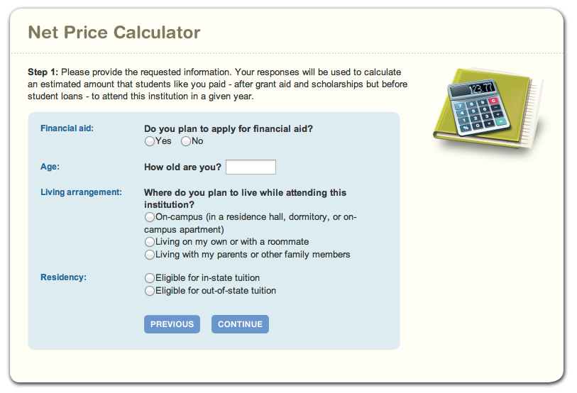
Southwest Tech Net Price Calculator (1 of 2)
Notes:
This is the net price calculator for Southwest Technical College. Southwest Technical College is a 2-year tech college in Fennimore, Wisconsin—which as the name suggests is in the southwest part of the state.
Lots of colleges use a net price calculator similar to this one, so you’ll probably see it quite often.
It’s easy to use and only asks a few questions including:
How old are you?
Where do you plan to live when you go to college?
How many people are in your family?
What is your family income?
It is important to note that these calculators are just online tools to gather information and ideas of cost. They aren’t to be used in place of applying for financial aid and receiving your actual aid offers. They are often programmed based on averages. So to get your actual net price you must complete the FAFSA!

Slide 20
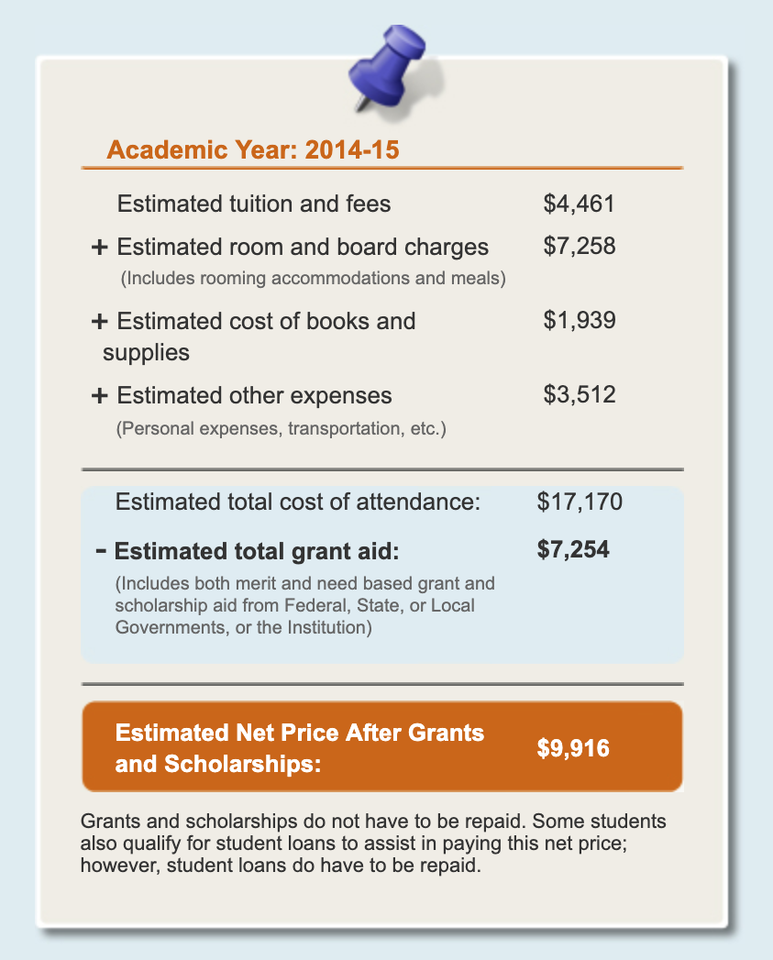
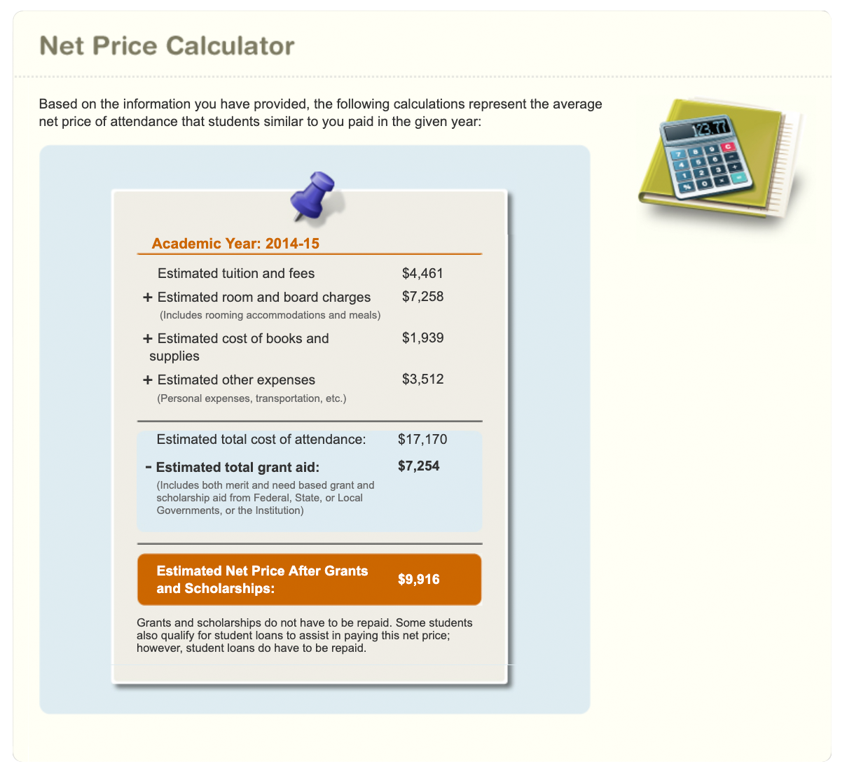
Southwest Tech Net Price Calculator (2 of 2)
Notes:
Based on information you provide, the calculator will give you an estimate of how much you might get in grants and scholarships and how much you can expect to pay to attend college there. Here’s an example.
[Click]
We see under Cost of Attendance
Tuition and Fees is $4,461, Room and Board is $7,258, Books and Supplies is $1,939, and Other Expenses (like transportation) is $3,512
[Click]
All that added together gives us a total cost of attendance of $17,170 [Click]
We also see under the Grants and Scholarships section that there is a College Grant and Scholarship of $7,254.
[Click]
When we subtract the total of the grants and scholarships from the cost of attendance, we get a net price of $9,916.

Slide 21
Cardinal Stritch University Net Price Calculator (1 of 2)
Notes:
Let’s look at another net price calculator example.
This is the net price calculator on Cardinal Stritch University’s website.
Cardinal Stritch is a private, 4-year university in Milwaukee, Wisconsin.
As I said, each college’s net price calculator may be a little different, and this one asks a few more questions than some of the other ones out there, including questions about GPA and ACT/SAT scores to determine if students qualify for an institutional scholarship.
It also asks some of the more standard net price calculator questions about you and your parent’s personal and financial information including:
How much each of you make, how much you pay in taxes, and the value of other assets.
The number of children in your family.
Where you plan to live in college

Slide 22
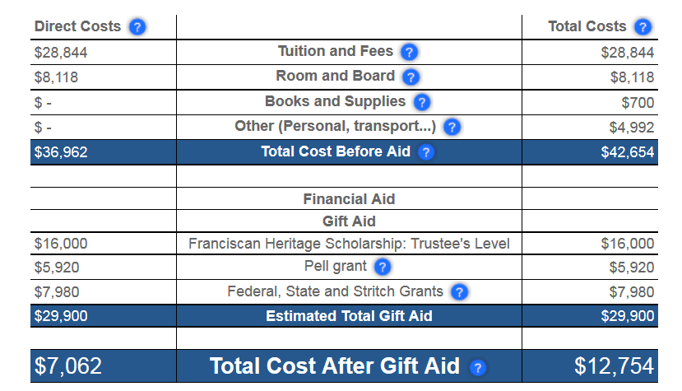
Cardinal Stritch University Net Price Calculator (2 of 2)
Notes:
This example uses the same student from a family of four with a family income of $30,000.
[Click]
Tuition and Fees: $28,844
Room and Board: $8,118
Books and Supplies: $700
And Personal Expenses: $4,992
[Click]
This give us a cost of attendance of $42,654.
For aid we see this student is being offered $16,000 for the Franciscan Heritage Scholarship; a $5,920 Federal Pell Grant; and $7,980 in State Grants and Scholarships.
[Click]
When we add all this together we get $29,900 in financial aid and scholarships.
[Click]
This gives us a net price of $12,754 after the gift aid is subtracted from the cost of attendance.
It’s worth noting that private colleges like this often give big grants and scholarships so students can attend, and it’s a good example of how a more expensive college may be affordable when financial aid is factored in.

Slide 23
NET PRICE REVIEW
Depends on
The sticker price of the college you attend
How much grant and scholarship money you receive
It might be more or less than your friend’s net price
Even if you go to the same college
Notes:
So let’s do a quick review of net price.
Remember sticker price—the full price of college—minus any grant and scholarship money you receive equals your net price.
Your net price will be unique to you. It might be more or less than your friend’s net price even if you go to the same college. It’s based on your financial situation.

Slide 24
How can you pay the rest?
HOW CAN YOU PAY THE REST?
Use savings (e.g. 529 College Savings Plan)
Apply for scholarships
Federal work-study
Federal student loans
Notes:
As we saw in our examples, grants and scholarships may not cover everything. So you need to make plans for how to pay for the rest.
One way is to use savings from jobs you have during high school and over the summer. Or maybe your family can help contribute. Some of you may have a 529 College Savings Plan to help when the time comes.
You should also apply for scholarships. There are lots of scholarships available from other sources besides colleges.
When you complete the FAFSA you’ll also be eligible for additional federal money in the form of work-study and student loans.

Slide 25
FINDING SCHOLARSHIPS
Search online
Niche.com
Petersons.com
Scholarships.com
Fastweb.com
Unigo.com
CollegeGreenlight.com
Talk to your counselor
Notes:
Scholarships can come from all kinds of sources. And these types of scholarships are available to all different kinds of students! Scholarships are awarded for many other things besides your GPA. There are scholarships out there for students who draw well (Doodle for Google) and there is even a “Zombie Apocalypse” scholarship where all you have to do to apply is submit a short written response (250 words) to a question about your high school being overrun by Zombies!
So where can you find these scholarships? The best place is online using sites such as:
Niche.com Petersons.com
Scholarships.com
Fastweb.com
Unigo.com
CollegeGreenlight.com
You can also look for scholarships based on things you do. For example, if you do a lot of volunteer work, Google “scholarships for community service,” “scholarships for social justice,” “scholarships for volunteering”—you will be surprised by what you find.
Talk to your high school counselor. They can be a good resource for identifying any local scholarships that are available and will be able to help you with your search.
Just be sure to avoid scholarship applications that cost money or require a credit card number. Those are a scam. Scholarship applications should be free.
You’ll need to fill out an application for each scholarship, but the time spent applying can pay very well. Think about this: if you spend one hour on an application and get $250, that’s more than any part-time job will pay—and definitely worth your time!

Slide 26
The FAFSA unlocks Federal work-study
The FAFSA unlocks
Federal
WORK-STUDY
Job provided by the college (usually 10-15 hours per week)
Money YOU EARN
WHILE YOU GO TO COLLEGE
Notes:
Work-study is money earned by working a job sponsored by the college, usually on campus. Colleges know of your interest in work-study if you check “yes” in the work-study box on the FAFSA. You should always check this box whether you think you will work or not! If you are offered work-study you don’t have to accept it, but it is a great way to earn more money to pay for personal and college expenses.
Work-study jobs are convenient because you can often work in between classes. These jobs can also be a way to meet and connect with new people.
Just like any job, you will get paid for the hours you work. You’ll receive a paycheck (sometimes every two weeks, sometimes monthly) that you can use for textbooks, food, or even tuition – it’s your choice what college expenses you use it for.

Slide 27
The FAFSA unlocks Federal Student loans
The FAFSA unlocks
Federal Student
LOANS
Borrow up to $5,500 your first year (and even more after that)
Money you borrow and repay with interest
Notes:
Loans may be necessary to help you pay for college, but explore all other options first.
Federal student loans are loans made by the federal government at a lower interest rate than a bank.
Student loans are money that is borrowed and has to be repaid with interest. You may be eligible to borrow up to $5,500 your first year. You can borrow up to $6,500 your second year and $7,500 per year after that. And some of you may be eligible to borrow even more per year depending on your situation.
[student interaction]
Does everyone know what interest means?
To put it simply—it’s the cost to borrow money. When you borrow money you need to pay it back plus an additional percentage of that money. The cost will vary depending on how much you borrow and how long it takes to pay it back.
Loans are paid back over an agreed amount of time rather than all at once. Generally you have up to 10 years to repay them after you’re out of school. You get all of your money upfront, but at a price, and that price is interest over time.
Some of you may worry about taking out student loans and don’t want to have to make a student loan payment once you graduate. Think of loans as an investment in your future – meaning if you get a college degree, you’ll have more and better opportunities to get a higher-paying job than if you don’t have a college degree.

Slide 28
Southwest Tech Calculation
−
−
−
$9,916
$17,170
$7,254
$9,916
Net Price
Sticker Price
Pell Grant and State Grant
Net Price
−
−
$17,170
$7,254
−
$9,916
Sticker Price
Pell Grant and State Grant
−
Net Price
−
−
$5,500
$4,416
Federal Student Loan
Cost not covered by financial aid
(may be less depending on additional scholarships)
Notes:
Ok, so now that we know what other financial aid is available to help cover the cost of college, let’s go back to our two examples.
First we have Southwest Tech and a net price of $9,916.
[Click]
Let’s see how federal student loans can help cover some of this cost. If we use the maximum amount $5,500 ($3,500 for federal direct subsidized and $2,000 for federal direct unsubsidized) that will leave $4,416 not covered by financial aid.
This $4,416 is an amount that could be covered by money from savings, additional scholarships, or a part-time job.

Slide 29
Cardinal Stritch Calculation
−
−
−
$12,754
$42,654
$29,900
$12,754
Net Price
Sticker Price
Pell Grant, State Grant and Institutional Scholarship
Net Price
−
−
$42,654
$29,900
−
$12,754
Sticker Price
−
Pell Grant, State Grant and Institutional Scholarship
Net Price
−
−
$5,500
$7,254
Federal Student Loan
Cost not covered by financial aid
(may be less depending on additional scholarships)
Notes:
Now let’s go back to our Cardinal Stritch example, which had a net price of $12,754.
[Click]
If we apply the maximum of federal student loans again, we are left with $7,254 not covered by financial aid.
Now, granted $7,254 is still a lot of money, but what this example shows us is that with the help of financial aid the cost was reduced from $42,654 to $7,254--a savings of $35,400. And that doesn’t account for work-study or additional scholarships.

Slide 30
Lots of money is available
College costs less than you might think
$4,416
$12,274
Notes:
The point is there is lots of money available to help you pay for college. Including free money in the form of grants and scholarships.
And looking back at our Southwest Tech example,
[Click]
I hope the one thing you take away from our time today is that while the sticker price may be high, the reality is college actually costs less than you might think it does.

Slide 31
TAKE ACTION
Go after the money available to help you pay for college
Complete the FAFSA®—you can’t get any federal financial aid if you don’t
Apply for scholarships—they are worth your time
Use a Net Price Calculator to estimate what college will cost you
Have a plan to pay for any costs not covered by financial aid
Notes:
But you need to take action to get it.
Go after the money available to help reduce the cost and pay for college.
You don’t want to pay the advertised sticker price for college, right?
Make sure you get any federal financial aid you are entitled to by completing the FAFSA.
You know who won’t get any financial aid? Students who don’t complete the FAFSA.
Don’t be one of those students—make sure you complete the FAFSA!
You also want to make sure you apply for scholarships. The time you spend could earn you more for college than a part-time job.
Use a Net Price Calculator to estimate what college will cost you
It’s a great tool to determine the cost of college after grants and scholarships are applied.
You can find a Net Price Calculator on every college’s website—simply search Net Price Calculator.
Have a plan to pay for any costs not covered by financial aid
Financial aid may not cover all your costs to go to college. Make sure you’re prepared for that situation.
Think about getting a job before college so you can start saving.

Slide 32
Thank you for attending
© 2019 Ascendium Education Group, Inc. All Rights Reserved.

